Slide 1
Wayne County Criminal Advocacy Program Seminar
October 23, 2015 Coleman A. Young Municipal Center Detroit, MI
Capt. Greg Michaud
Michigan State Police
Forensic Science Division

Slide 2
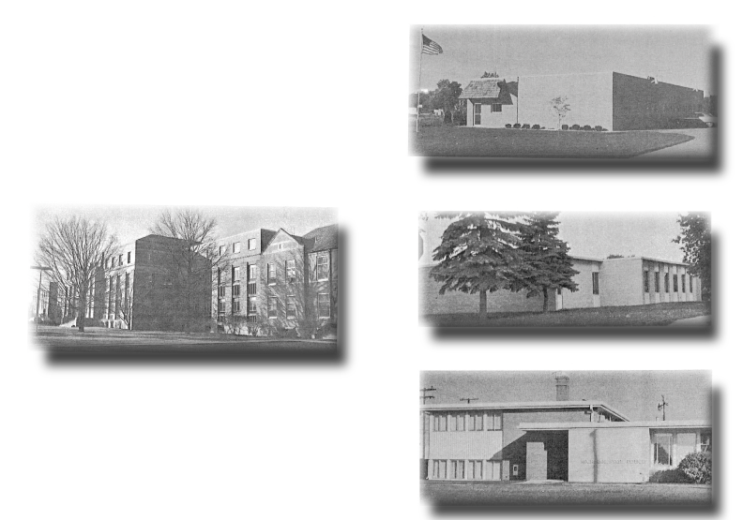
Forensic Science Division – Then & Now
Holland Laboratory (1972)
East Lansing Central Laboratory (1932 - MSP Headquarters)
Plymouth Laboratory (1969)
Warren Laboratory (1969)
“A PROUD tradition of SERVICE through EXCELLENCE, INTEGRITY and COURTESY.”.

Slide 3
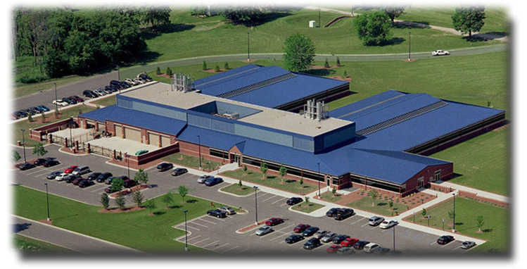
Lansing Forensic Laboratory
Services
Biology (DNA & Screening)
CODIS
Controlled Substances
Crime Scene Investigation
Firearms & Toolmarks
Latent Prints
Polygraph
Questioned Documents
Toxicology
Trace Evidence
“A PROUD tradition of SERVICE through EXCELLENCE, INTEGRITY and COURTESY.”.

Slide 4
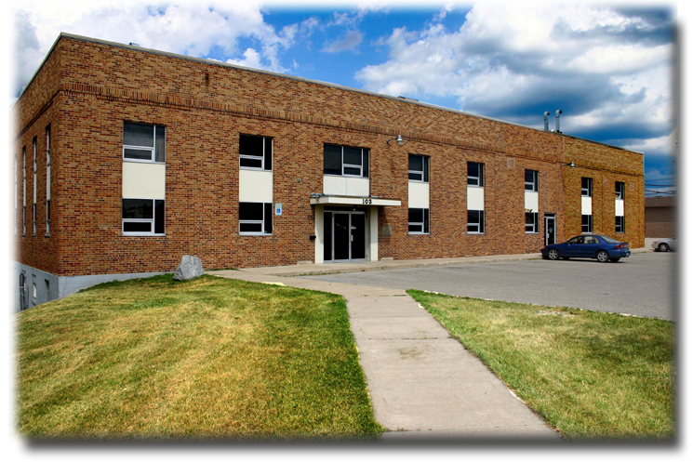
Grayling Forensic Laboratory
Services
Biology (Screening)
Controlled Substances
Crime Scene Investigation
Firearms & Toolmarks
Latent Prints
Polygraph
Trace Evidence
“A PROUD tradition of SERVICE through EXCELLENCE, INTEGRITY and COURTESY.”.

Slide 5
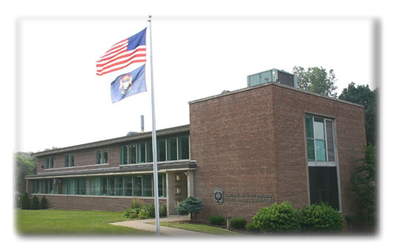
Grand Rapids Forensic Laboratory
Services
Biology (DNA & Screening)
Controlled Substances
Crime Scene Investigation
Firearms & Toolmarks
Latent Prints
Trace Evidence
“A PROUD tradition of SERVICE through EXCELLENCE, INTEGRITY and COURTESY.”.

Slide 6
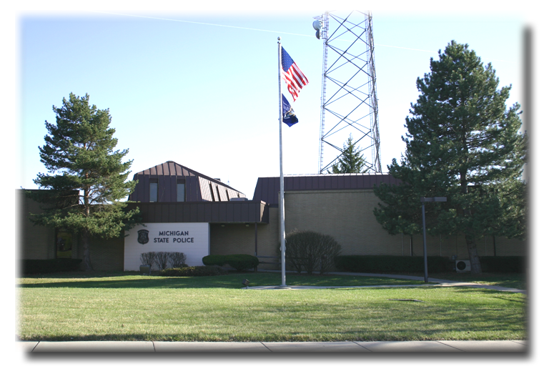
Northville Forensic Laboratory
Services
Biology (DNA & Screening)
Controlled Substances
Crime Scene Investigation
Latent Prints
Polygraph
Trace Evidence
“A PROUD tradition of SERVICE through EXCELLENCE, INTEGRITY and COURTESY.”.

Slide 7
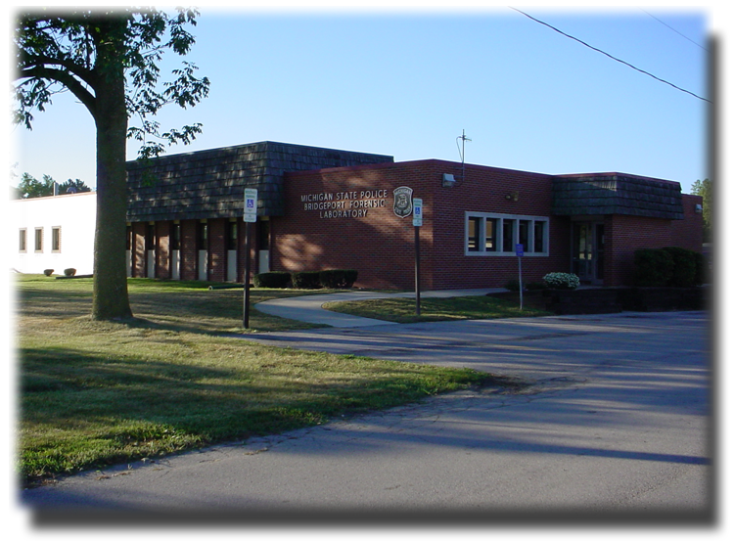
Bridgeport Forensic Laboratory
Services
Biology (Screening only)
Controlled Substances
Crime Scene Investigation
Firearms & Toolmarks
Latent Prints
Trace Evidence
Questioned Documents
“A PROUD tradition of SERVICE through EXCELLENCE, INTEGRITY and COURTESY.”.

Slide 8
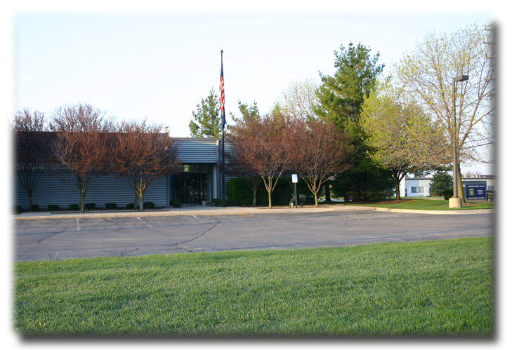
Sterling Heights Forensic Laboratory
Services
Biology (Screening only)
Controlled Substances
Crime Scene Investigation
Latent Prints
Trace Evidence
“A PROUD tradition of SERVICE through EXCELLENCE, INTEGRITY and COURTESY.”.

Slide 9
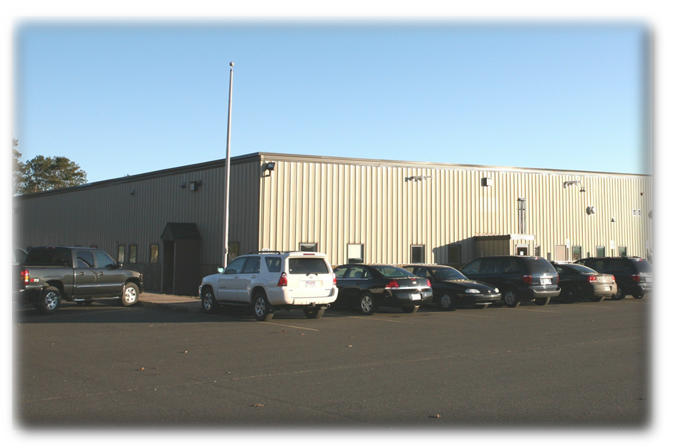
Marquette Forensic Laboratory
Services
Controlled Substances
Biology (Screening only)
Toxicology (Blood alcohols only)
Crime Scene Investigation
Latent Prints
Polygraph
“A PROUD tradition of SERVICE through EXCELLENCE, INTEGRITY and COURTESY.”.

Slide 10
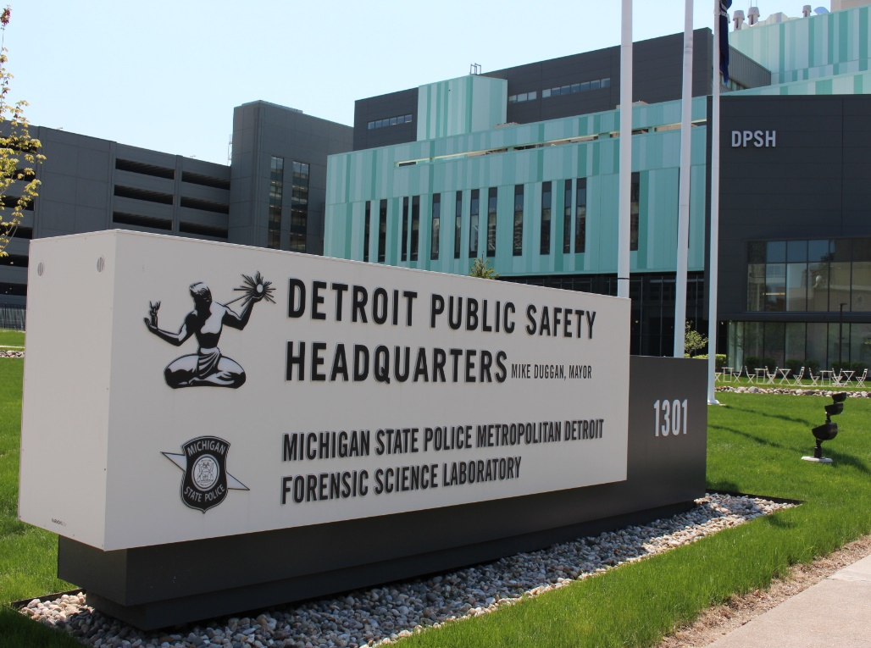
Metro Detroit Forensic Laboratory
Services
Firearms & Toolmarks
Evidence Reception
Crime Scene Investigation
Controlled Substances (Dec. 2015)
“A PROUD tradition of SERVICE through EXCELLENCE, INTEGRITY and COURTESY.”.

Slide 11
Question 8
When should I have an expert look at my lab reports?
Wayne County Criminal Advocacy Program Seminar

Slide 12
Accreditation of msp laboratories
An Overview of the ASCLD/LAB-International Accreditation Process

Slide 13
What is accreditation?
Accreditation is
Recognition of compliance with a set of requirements
Certification of competence in a specified subject or areas of expertise.
Accreditation is awarded to an organization by a recognized accrediting organization

Slide 14
why is accreditation important for MSP laboratories?
Lab accreditation is a way to signify technical competence to perform specific types of testing.
Accreditation provides
formal recognition to competent labs
our customers and stakeholders a way to identify and select reliable services to meet their needs
The laboratory also is able to ensure it is performing its work correctly and is meeting the appropriate standards

Slide 15
ASCLD, ISO, & ASCLD/LAB
ASCLD
ASCLD is an organization similar to a working group for forensic Lab Directors
ISO
ISO is an organization that sets standards and guidelines
ASCLD/LAB
ASCLD/LAB is the forensic Laboratory Accreditation Board (LAB)
MSP Laboratories are accredited by ASCLD/LAB.
We are part of the ASCLD/LAB-International program which simply means we are accredited to the ISO standard for testing laboratories, “ISO/IEC 17025”.

Slide 16
iso/iec 17025
ISO/IEC 17025 lists the general requirements for the competence of testing and calibration laboratories.
Some requirements in ISO/IEC 17025 are:
The laboratory’s policies related to quality shall be defined in a quality manual
All documents shall be reviewed and approved for use prior to issue
The records for each test shall contain sufficient information to enable the test to be repeated
These probably sound familiar!
ISO 17025

Slide 17
Supplemental requirements for ascld/lab accreditation
In addition to the requirements in ISO/IEC 17025, laboratories accredited by ASCLD/LAB have Supplemental requirements specific to forensic science testing laboratories
Some of the supplemental requirements for forensic labs are
Annual review of testimony
Annual proficiency testing
Technical and administrative review of examination and case records
ISO 17025
Supplemental

Slide 18
and even more requirements… our own!
We also are required to follow requirements that we have implemented ourselves within our Division:
The starting and ending dates of analysis are recorded within Forensic Advantage.
The case record shall contain… the FSD-007….
A report must be prepared for any evidence submitted
We are assessed on compliance with all the requirements: ISO/IEC 17025, ASCLD/LAB-International Supplemental, and our own.
ISO 17025
Supplemental
FSD Procedure

Slide 19
assessment
An assessment is
the review of conformance, competence, and effectiveness of a laboratory to meet accreditation standards
It is accomplished by
collecting objective evidence of conformance, competence, and effectiveness
Assessment is done by assessors
who have been trained by ASCLD/LAB
who are familiar with the accreditation standards
who have reviewed the policies and procedures of the Forensic Science Division

Slide 20
On-Site Assessment
The on-site assessment of a laboratory allows assessors to interview employees and witness performance of job functions.
Interviews and witnessing of casework allow the assessors to collect evidence of
Conformance
Competence
Effectiveness of the laboratory
Assessors also review case records to see how the policies and procedures of the laboratory have been applied and adhered to.

Slide 21
What happens after an assessment?
The Assessment team will determine if the laboratory conforms to each accreditation requirement.
If a laboratory does not conform to a requirement, it is termed a “nonconformance”.
The assessment team will present the assessment conclusions, including any nonconformance, to FSD Management in a Preliminary Assessment Report on the last day of the assessment.

Slide 22
Then…
The preliminary report is reviewed at ASCLD/LAB, and then a Full Assessment Report is issued to the laboratory.
If a nonconformance is identified during the assessment, the laboratory will develop a corrective action plan to resolve the nonconformance.
Once all corrective actions have been resolved, the Final Assessment Report is presented to the ASCLD/LAB Board.
The decision to grant accreditation may only be made by the ASCLD/LAB Board, and is made prior to the expiration of current ASCLD/LAB accreditation.

Slide 23
The accreditation cycle
ASCLD/LAB accreditation is granted for a period of four years.
Prior to 2015, accreditation was granted for a period of five years.
Periodic surveillance visits are conducted to monitor ongoing conformance with accreditation requirements
The surveillance visits may be scheduled every 12 to 24 months of the accreditation cycle
The schedule and frequency of surveillance visits is determined by ASCLD/LAB

Slide 24
References and more information
ISO/IEC 17025 and ASCLD/LAB Supplemental requirements are found on the FSD document site
MSP-FSD Requirements are found in our quality, Lab operations, and Discipline manuals.
www.ascldlab.org
www.ilac.org
https://www.fbi.gov/about-us/lab/biometric-analysis/codis/stds_testlabs

Slide 25
Closure of Detroit Crime Laboratory

Slide 26
Case Statistics by Discipline Calendar Year End 2000
CASES RECEIVED
AVERAGE TURN-AROUND TIME (DAYS)
CASE BACKLOG
Controlled Substances = 29,095
Latent Prints = 11,664
Firearms & Toolmarks = 2,761
Biology = 4,048
(DNA & Serology combined)
Toxicology = 14,837 (BA & Drug Screen combined)
Trace Evidence = 2,713
Questioned Documents = 474
CODIS = 2,747
Controlled Substances = 14
Latent Prints = 23
Firearms & Toolmarks = 17
Biology DNA= 46 Serology = 37
Toxicology Blood Alcohol = 8 Drug Screens = 30
Trace Evidence = 30
Questioned Documents = 15
CODIS = 0
Controlled Substances = 375
Latent Prints = 966
Firearms & Toolmarks = 88
Biology = 360 (DNA & Serology combined)
Toxicology = 104 (BA & Drug Screen combined)
Trace Evidence = 216
Questioned Documents = 5
CODIS = 15,573
Total = 65,592 cases
Total = 2,114 cases
“A PROUD tradition of SERVICE through EXCELLENCE, INTEGRITY and COURTESY.”.

Slide 27
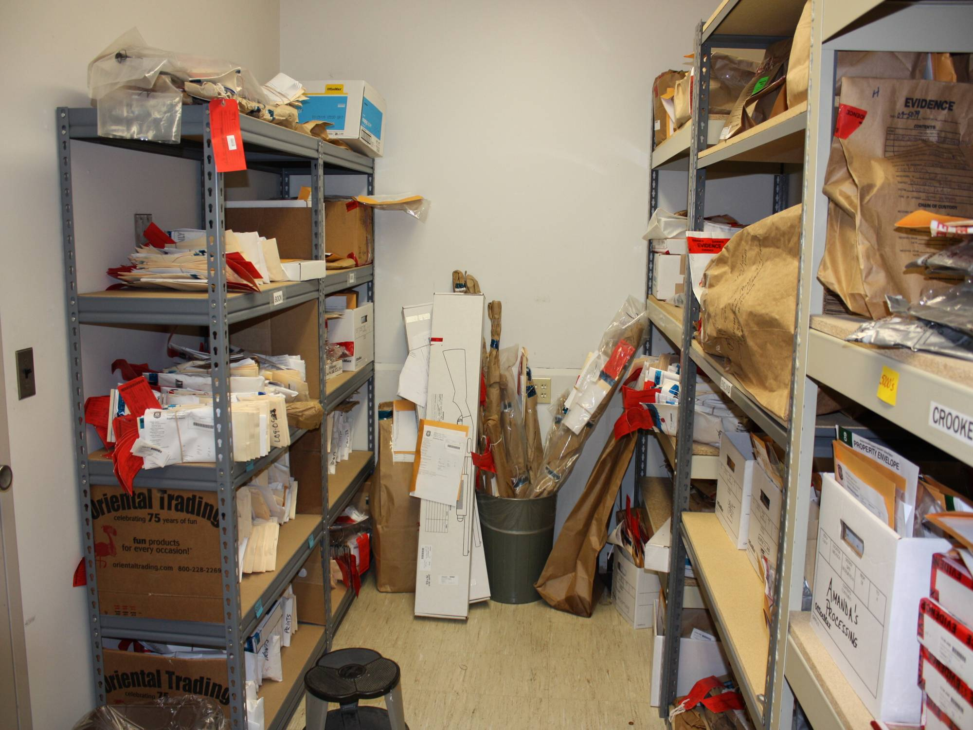
Northville Forensic Laboratory Latent Print Unit
“A PROUD tradition of SERVICE through EXCELLENCE, INTEGRITY and COURTESY.”.

Slide 28
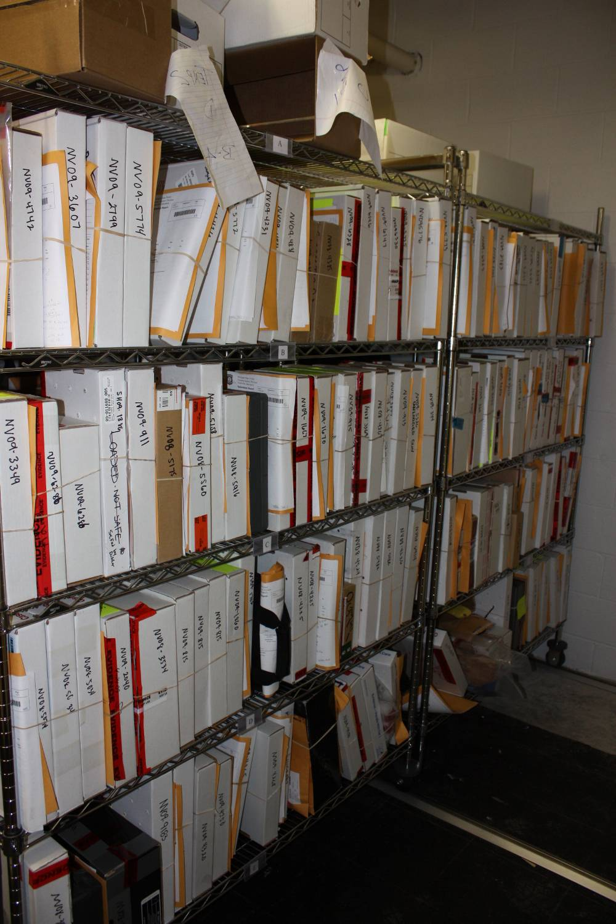
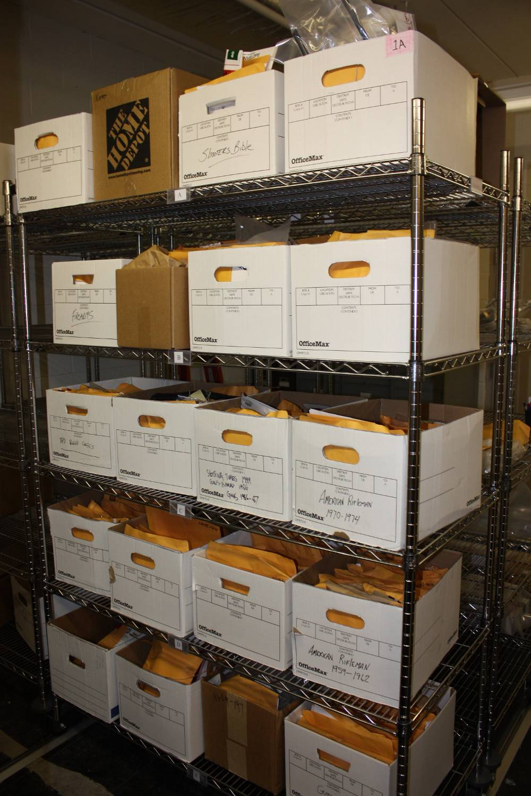
Northville Forensic Laboratory Non-DPD Firearms Cases to be Completed
“A PROUD tradition of SERVICE through EXCELLENCE, INTEGRITY and COURTESY.”.

Slide 29
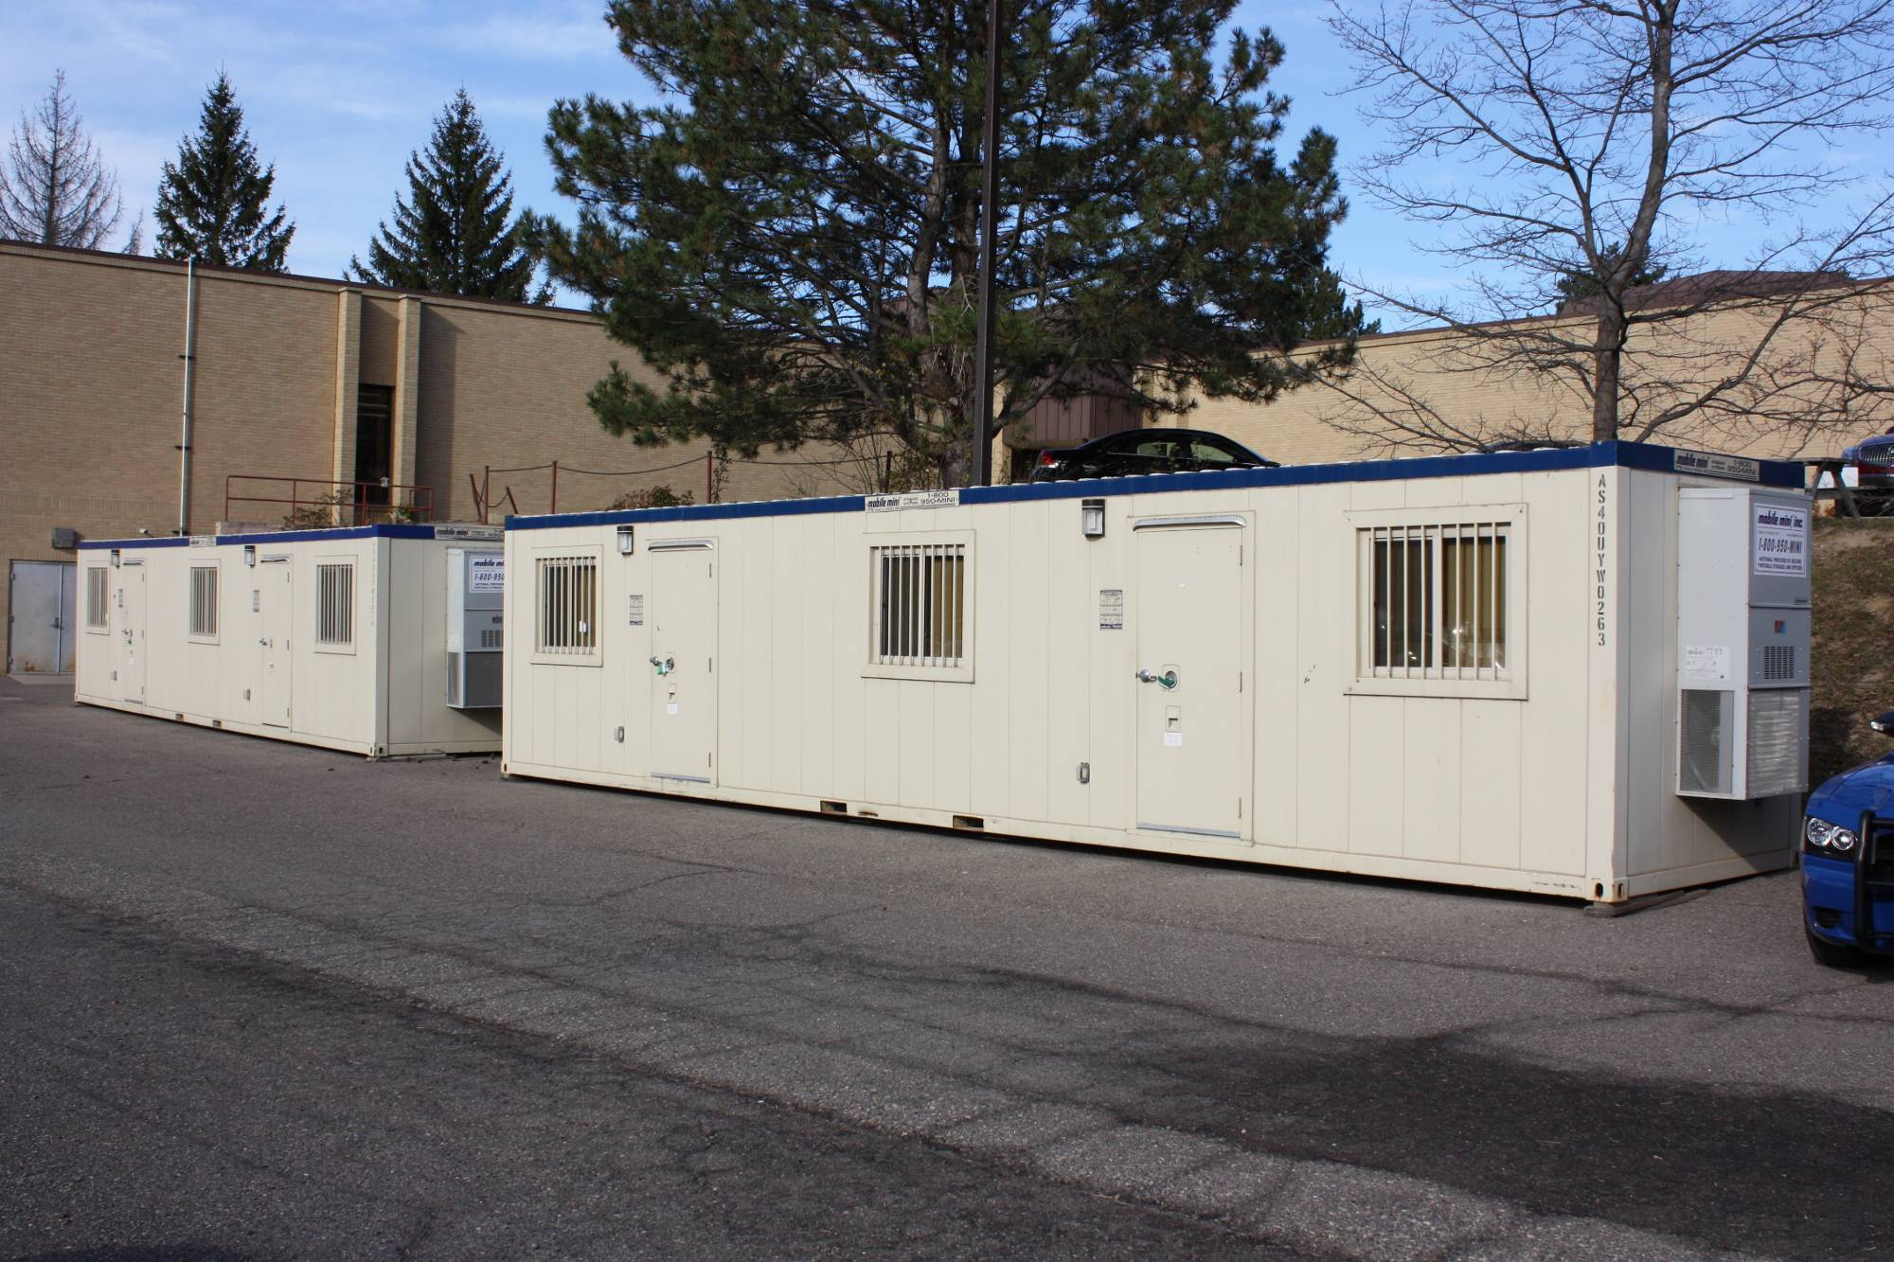
Northville Forensic Laboratory
40ft. x 8ft. Evidence Storage Units
“A PROUD tradition of SERVICE through EXCELLENCE, INTEGRITY and COURTESY.”.

Slide 30
2009 Case Statistics by Discipline
CASES RECEIVED
AVERAGE TURN-AROUND TIME (DAYS)
CASES BACKLOG
Controlled Substances = 28,600
Latent Prints = 11,728
Firearms & Toolmarks = 7,691
Biology = 9,055
(DNA & Serology combined)
Toxicology = 21,106 (BA & Drug Screen combined)
Trace Evidence = 1,629
Questioned Documents = 217
CODIS = >25,000
Controlled Substances = 23
Latent Prints = 36
Firearms & Toolmarks = 91
Biology DNA= 140 Serology = 101
Toxicology Blood Alcohol = 14 Drug Screens = 75
Trace Evidence = 35
Questioned Documents = 103
CODIS = 10
Controlled Substances = 4,516
Latent Prints = 2,312
Firearms & Toolmarks = 6,059
Biology = 2,613 (DNA & Serology combined)
Toxicology = 1,329 (BA & Drug Screen combined)
Trace Evidence = 275
Questioned Documents = 64
CODIS = 1,650
Total = 80,026 cases
Total = 17,168 cases
“A PROUD tradition of SERVICE through EXCELLENCE, INTEGRITY and COURTESY.”.

Slide 31
Case Statistics by Discipline 2000 vs 2009
AVERAGE TURN-AROUND TIME (DAYS)
CASE BACKLOG
2000 vs 2009
2000 vs 2009
Cont. Substances = 14
Latent Prints = 23
Firearms & Toolmarks = 17
Biology DNA= 46 Serology = 37
Toxicology Blood Alcohol = 8 Drug Screens = 30
Trace Evidence = 30
Questioned Documents = 15
CODIS = N/A
Cont. Substances = 23
Latent Prints = 36
Firearms & Toolmarks = 91
Biology DNA= 140 Serology = 101
Toxicology Blood Alcohol = 14 Drug Screens = 75
Trace Evidence = 35
Questioned Documents = 103
CODIS = 10
Cont. Substances = 375
Latent Prints = 966
Firearms & Toolmarks = 88
Biology = 360 (DNA & Serology combined)
Toxicology = 104 (BA & Drug Screen combined)
Trace Evidence = 216
Questioned Documents = 5
CODIS = 0
Cont. Substances = 4,516
Latent Prints = 2,312
Firearms & Toolmarks = 6,059
Biology = 2,613 (DNA & Serology combined)
Toxicology = 1,329 (BA & Drug Screen combined)
Trace Evidence = 275
Questioned Documents = 64
CODIS = 1,650
2013 MSP Strategic Plan
Total = 2,714 Total = 17,168
“A PROUD tradition of SERVICE through EXCELLENCE, INTEGRITY and COURTESY.”.

Slide 32
Cases Completed by Discipline 2000 vs 2012
2000
2012
Controlled Substances = 29,095
Latent Prints = 11,664
Firearms & Toolmarks = 2,761
Biology = 4,048 (DNA & Serology combined)
Toxicology = 14,837 (BA & Drug Screen combined)
Trace Evidence = 2,713
Questioned Documents = 474
Controlled Substances = 29,321
Latent Prints = 13,130
Firearms & Toolmarks = 5,478
Biology = 9,716 (DNA & Serology combined)
Toxicology = 21,596 (BA & Drug Screen combined)
Trace Evidence = 2,084
Questioned Documents = 325
65,592 cases completed
78,239 cases completed
“A PROUD tradition of SERVICE through EXCELLENCE, INTEGRITY and COURTESY.”.

Slide 33
FSD Backlog
NUMBER OF CASES BACKLOGGED
2000
2009
2013
Controlled Substances = 375
Latent Prints = 966
Firearms & Toolmarks = 88
Biology = 360 (DNA & Serology combined)
Toxicology = 104 (BA & Drug Screen combined)
Trace Evidence = 216
Questioned Documents = 5
Controlled Substances = 4,516
Latent Prints = 2,312
Firearms & Toolmarks = 6,059
Biology = 2,613 (DNA & Serology combined)
Toxicology = 1,329 (BA & Drug Screen combined)
Trace Evidence = 275
Questioned Documents = 64
Controlled Substances = 1,694
Latent Prints = 376
Firearms & Toolmarks = 1,352
Biology = 3,327 (DNA & Serology combined)
Toxicology = 4,026 (BA & Drug Screen combined)
Trace Evidence = 248
Questioned Documents = 82
Total = 2,714
Total = 17,168
Total = 11,105
“A PROUD tradition of SERVICE through EXCELLENCE, INTEGRITY and COURTESY.”.

Slide 34
Detroit Police Department Sexual Assault Kit Initiative
“A PROUD tradition of SERVICE through EXCELLENCE, INTEGRITY and COURTESY.”.

Slide 35
Question 6
What is the difference between STR and Y-STR testing?
The benefits of using Y-STR analysis in criminal cases stem from the fact that Y-STRs focus solely on short tandem repeats (STRs) that exist along the Y chromosome. Because females do not have Y chromosomes as part of their genetic material, all female contributions in an evidence stain are virtually ignored with Y-STR analysis. This fact is very advantageous when analyzing evidence samples that contain high levels of female DNA and only a very small amount of male DNA. All paternally-linked males have the same Y-STR profile.
Wayne County Criminal Advocacy Program Seminar

Slide 36
What’s happening today ?

Slide 37
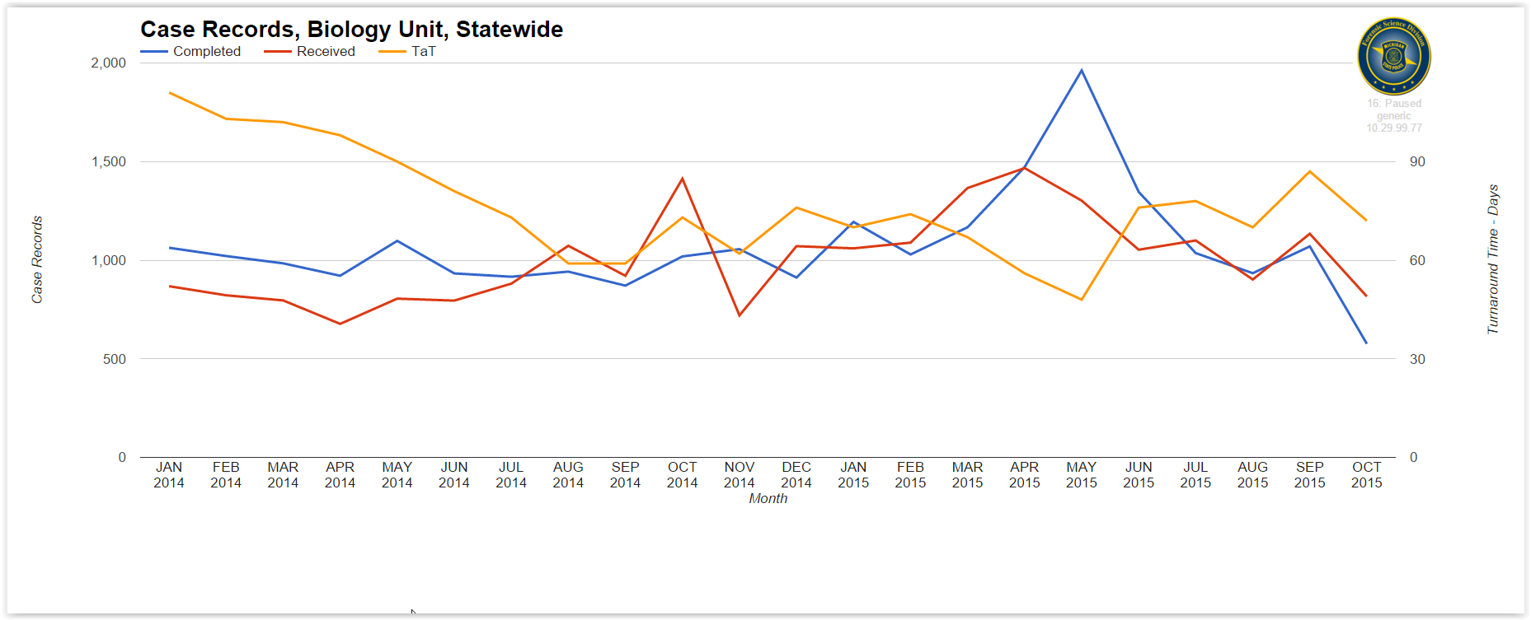
FSD’s Case Management – Forensic Advantage
Biology

Slide 38
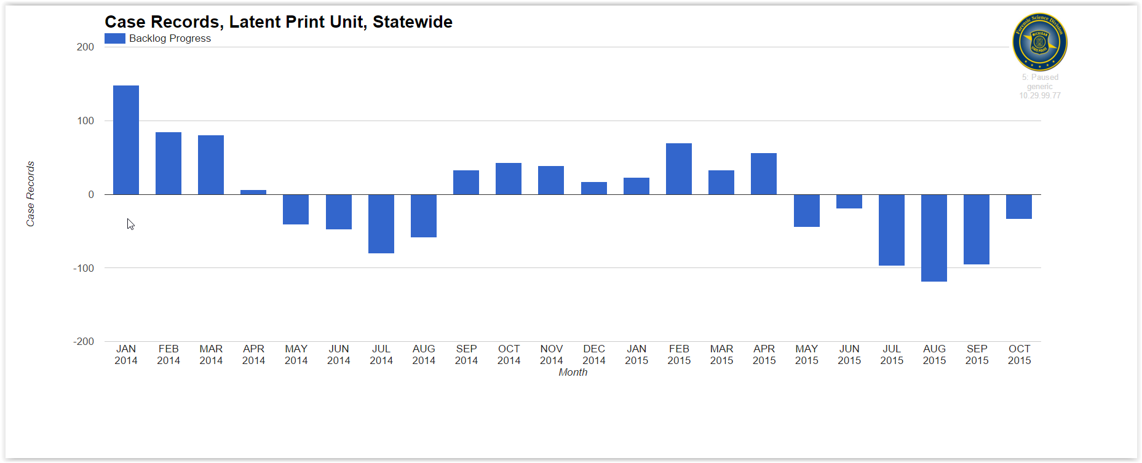
FSD’s Case Management – Forensic Advantage
Latent Prints

Slide 39
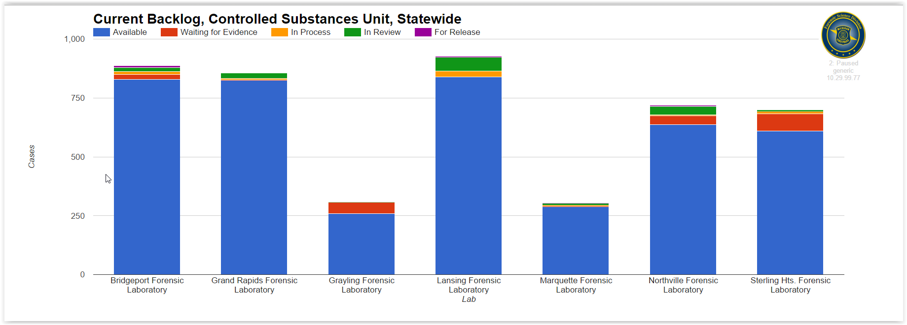
FSD’s Case Management – Forensic Advantage
Controlled Substances

Slide 40
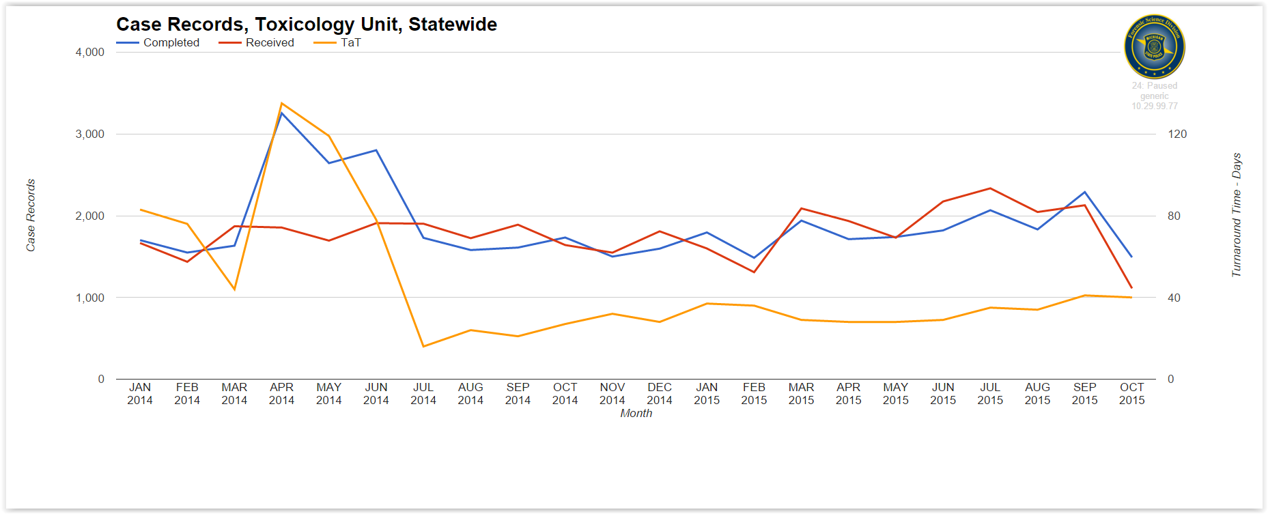
FSD’s Case Management – Forensic Advantage
Toxicology

Slide 41
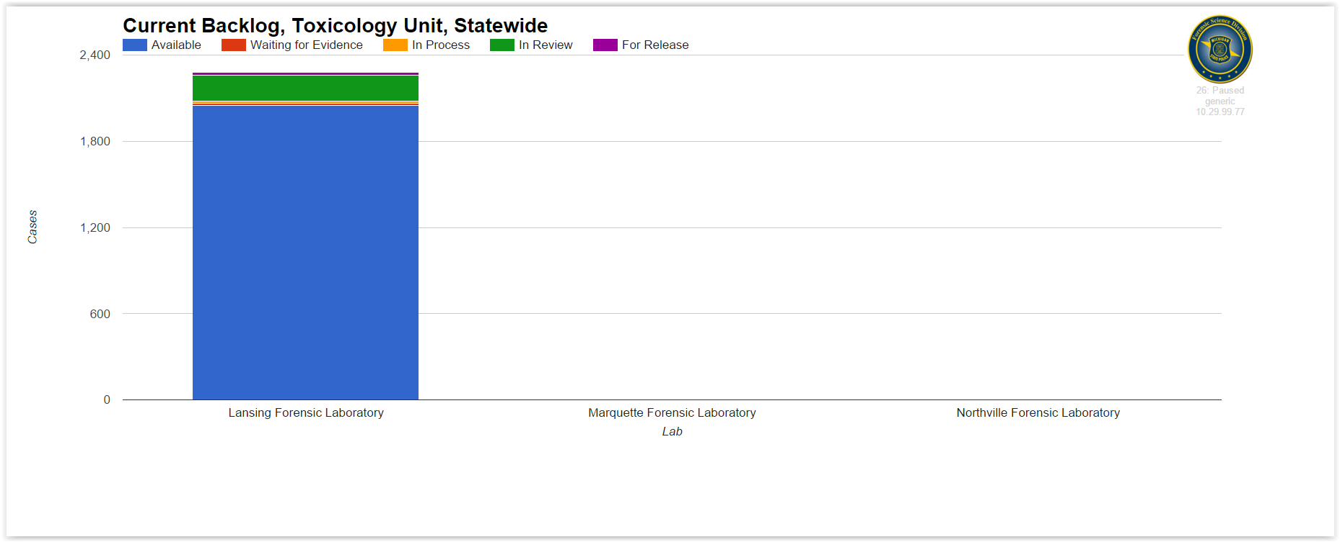
FSD’s Case Management – Forensic Advantage
Toxicology

Slide 42
Question 2
How do I know if I have all of the lab reports in a case?
Wayne County Criminal Advocacy Program Seminar

Slide 43
Question 9
How do I read my lab report? What if I don’t understand something on the report?
Wayne County Criminal Advocacy Program Seminar

Slide 44
Question 4
Are MSP scientists willing to speak to defense attorneys prior to court appearance if they have questions about the tests performed, the results etc…?
Mr. Jeff Nye
Biology (DNA)
NyeJ1@michigan.gov
Mr. Nick Fillinger
Toxicology
FillingerN@Michigan.gov
Ms. Elizabeth Gormley
Controlled Substances
GormleyE@michigan.gov
Ms. Cheryl Lozen
Trace Evidence / Documents
LozenC@michigan.gov
F/Lt. Andy Carriveau
Firearms / Toolmarks
CarriveauA@michigan.gov
Ms. Tracee McIntosh
Latent Prints
McintoshT@michigan.gov
Mr. Guy Nutter
Crime Scenes
NutterG@michigan.gov
Wayne County Criminal Advocacy Program Seminar

Slide 45
Question 5
Are MSP forensic scientists trained on how to testify in court? How are they told to respond to questions on cross examination?
Wayne County Criminal Advocacy Program Seminar

Slide 46
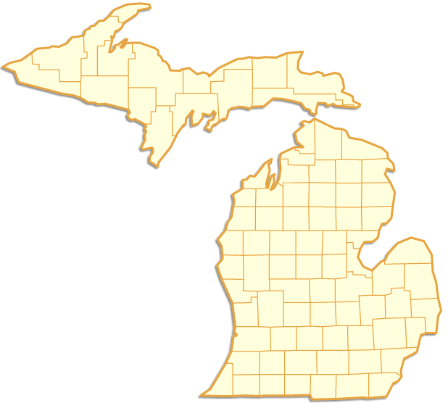
Video Testimony / Electronic Subpoenas
Since September 2007 approximately * 65,536 subpoenas entered
January 2013 to present
Section | Court Appearances | Times Testified | Travel Time (Hours) | State Mileage | Personal Mileage
Biology Unit | 2339 | 815 | 1338.11 | 33045.3 | 3490.6
Firearms/Toolmarks Unit | 827 | 353 | 472.52 | 11335.5 | 320.5
Questioned Document Unit | 14 | 8 | 31 | 2010 | 0
Controlled Substances Unit | 1365 | 359 | 706.68 | 22722.5 | 768
Latent Print Unit | 563 | 165 | 265.15 | 7700 | 58
Toxicology Unit | 4350 | 373 | 754.68 | 27441.2 | 340
Trace Evidence Unit | 173 | 82 | 185.15 | 8240 | 20
Totals: | 9631 | 2155 | 3753.29 | 112494.5 | 4997.1
Amendment of Rule 2.506 of the Michigan Court Rules allows for the electronic submission of subpoenas.

Slide 47
What’s Happening Today ?
Video Testimony
Court rule (MCR 6.006) recommendation is under consideration that will allow the Judges more discretion as to when video is an appropriate method for expert witness testimony.
“A PROUD tradition of SERVICE through EXCELLENCE, INTEGRITY and COURTESY.”.

Slide 48
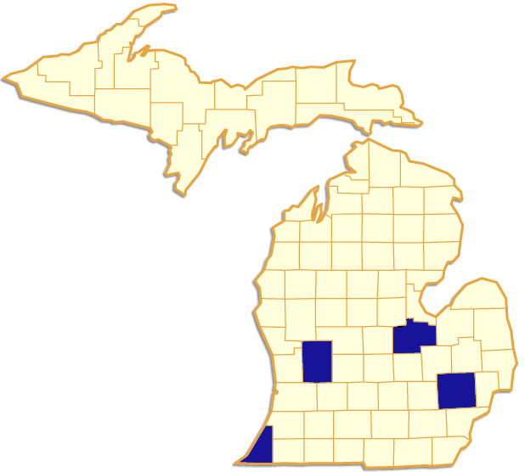
Case Management Interface
FSD’s Forensic Advantage (FA) and PAAM’s Adult Case Tracking (ACT) Systems
79 counties utilize PAAM’s ACT
Berrien
Kent
Oakland
Saginaw

Slide 49
Case Management Interface
FSD’s Forensic Advantage (FA) and PAAM’s Adult Case Tracking (ACT) Systems

Slide 50
Question 7
Where can I find the MSP Forensic Laboratory’s training and procedures manuals?
Wayne County Criminal Advocacy Program Seminar

Slide 51
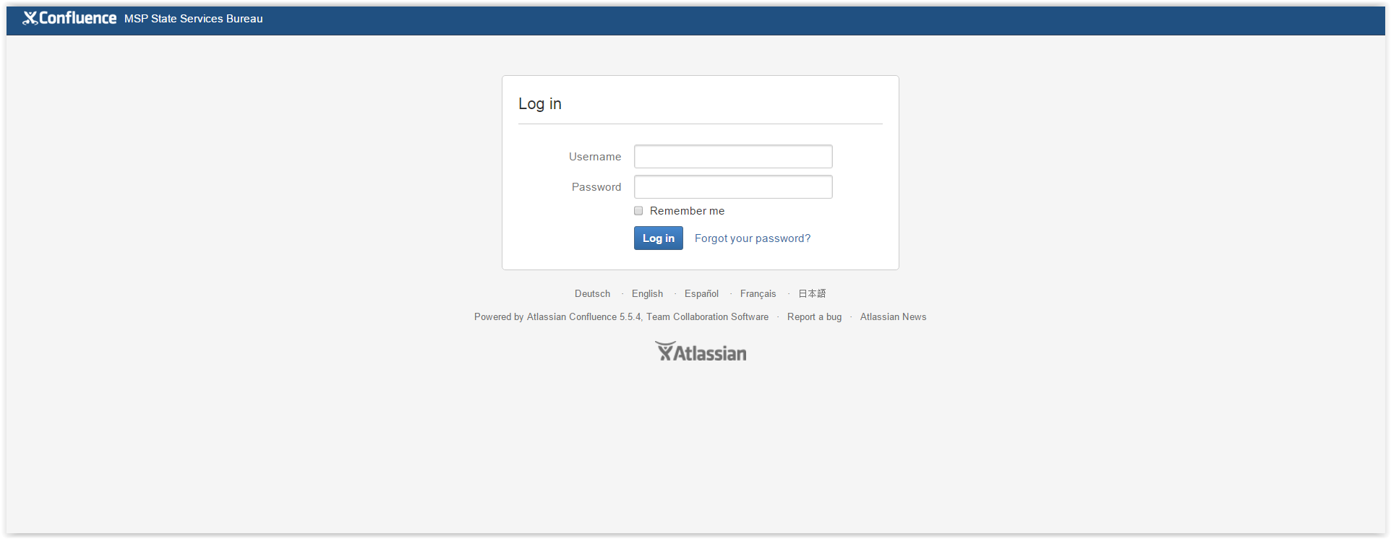
What’s Happening Today ?
FSD Documentation Management Site
http://www.mspsttbureau.org
Username: michigansado
Password: 123456
“A PROUD tradition of SERVICE through EXCELLENCE, INTEGRITY and COURTESY.”.

Slide 52
Question 3
Is there a limit on the number of items of evidence the MSP will DNA test for one case? If so, how many?
Wayne County Criminal Advocacy Program Seminar

Slide 53
Question 1
Does the Michigan State Police Forensic Laboratory believe or take the position that it works for the prosecutor’s office?
(1986 Karl Vinson case)
Wayne County Criminal Advocacy Program Seminar

