Slide 1
LIGHTS, CAMERA, ACTION!
TELLING YOUR TRIAL STORY THROUGH CROSS-EXAMINATION

Slide 2
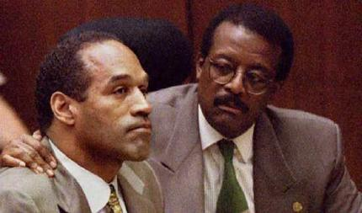
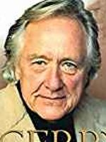
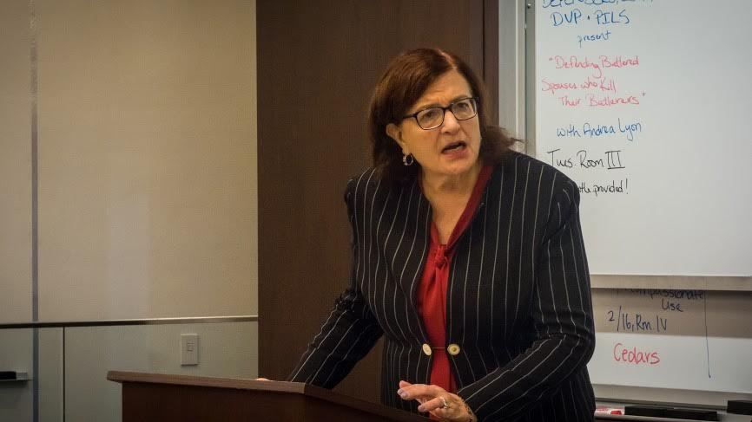
IT’S STORYTIME
This Photo by Unknown Author is licensed under CC BY-NC-ND
This Photo by Unknown Author is licensed under CC BY-SA-NC

Slide 3
Cross-examination: art or science?
“Referring to cross-examination as an art conveys the erroneous message that some trial lawyers have the talent to cross-examine while others don’t. It assumes cross-examination has no rules or fixed reference points. It cannot be taught or learned, but only viewed in wonderment and awe. “
--Cross-Examination: Science and Techniques, Pozner & Dodd

Slide 4
WRITING THE SCRIPT: Developing a Theory
What is a defense theory?
A persuasive statement that justifies the verdict you are seeking. Your theory is the structure around which the story you tell will be developed. The case theory gives your story shape. It provides the theme, sets out the characters, and provides the emotion necessary to move the jury.

Slide 5
A DEFENSE theory is not a legal defense
The Government will not be able to prove BRD that my client is guilty.
The complainant misidentified my client.
Client acted in self-defense.
That’s your legal defense. The defense tells us something about the legal rationale as to why a client is not guilty. It gives us a very general idea as to why a client isn’t guilty. But it says nothing about the tactical decision we will make in order to get to not guilty.

Slide 6
Examples of Defense theories
“The snitch was looking at a 25-year mandatory sentence so he made up a story about the client confession.”
Decedent, who was 6’4 and a former offense lineman, kept coming and pushing the fight, forcing poor, frail client who was 5’6 and a 125 lbs to shoot in order to save his own life.
Sgt. Robinson was under pressure to quickly solve this case so she cut corners in her investigation and ignored other leads.

Slide 7
Three Components of a good theory
Factual Component
Legal Component
Emotional Component

Slide 8
Factual component: FACTS BEYOND CHANGE (FBC)
FBC: FBC’s are facts that will be believed by the jury as fair, accurate, and highly relevant regardless of best efforts to dispute or modify them.
Any good theory must either incorporate all facts beyond change, or be neutral to them. That is, a theory must either build upon the FBC, or stand in harmony with them. A successful theory of the case can never contradict a FBC, because, if the fact finder is confronted with a theory and an actuality (an FBC), and the two cannot exist simultaneously, the fact finder must decide the case in accordance with the actuality (the fbc).

Slide 9
Examples of FBC
Complainant was shot four times in the back
Client’s BAC was 3x the legal limit
Witness entered into a cooperation agreement
Weather
Lighting
Stolen property in client’s possession
Drug results

Slide 10
FACTS BEYOND CHANGE: DON’T stop with the negative
Example: A search of Kristin Lavoy’s suitcase while at DTW yields 2 kilos of cocaine and a bag of Oxy pills . The issue is whether Ms. Lavoy consented to a search of her suitcase. Assume the following facts beyond change:
When she was initially stopped she protested
She refused to signa a Miranda form
Officers never advised of her right to leave w/o being searched
She pulled her suitcase towards her
Four DEA agents surrounded her
Agents were armed and uniformed
At no time did she manifest an attitude of cooperation.

Slide 11
WHY CROSS EXAMINE? TO ADVANCE THEORY/Story OF the CASE! That’s it.
Highlighting helpful facts.
Putting harmful facts in context
Attacking witness credibility.
Mistaken
Lying
Bias
Unreliable
Combination
DO NOT REPEAT THE DIRECT!!

Slide 12
WHY cross-examine? NO QUESTIONS, JUDGE
Does this witness help you advance your theory of the case?
Saying “no questions” sends a message to the jury that the witness means nothing to you and didn’t say or do anything to hurt your client’s case.

Slide 13
THEORY FOR THE WITNESS
What do you want FF to believe about this witness
This witness is bias
This witness was sloppy in her investigation
This witness is mistaken
This witness is lying

Slide 14
MAKE CHAPTERS FOR EACH WITNESS
One discrete point that supports your theory of the case and theory of the witness
Theory: Gov’t witness lying on your client to avoid prison sentence
Sammy Snitch Chapters:
Reason to doubt Sammy Snitch testimony because he has snitched in the past and received a benefit;
Reason to doubt Sammy Snitch’s testimony because he was facing 25 mandatory years before making deal with government;
Reason to Doubt Sammy Snitch’s testimony because he told a completely different story before he was given the plea deal

Slide 15
ONE CHAPTER PER PAGE
Easier to reorganize, add, or delete chapters mid-trial
Easy to reference mid-cross
Leads to less reliance on notes

Slide 16
ARRANGE THE ORDER OF YOUR CHAPTERS
Primacy and Recency
Use Safe, strong points after risky, weaker ones
Use order of chapters to tell your story of the witness.

Slide 17
Write out questions for each chapter
1st Responder to crime scene important
First responder
First responder has responsibilities
Securing crime scene
Secure crime scene to make sure nothing contaminates it
Make sure ppl don’t walk through it
Collect evidence
Gloves

Slide 18
SOURCE YOUR FACTS
Source all of your facts
Had been drinking (Carter, Supp Rpt, Pg 3)
Heard 5 shots (Griggs, Search Warrant Affidavit, pg 4)
Decedent 5 shots to back (Med. Exam Report pg 4)

Slide 19
MAKING STATEMENTS(ASKING questions) LEAD LEAD LEAD LEAD LEAD
Leading questions DECLARE the answer: Officer, you were not wearing gloves when you handled the evidence.
Leading Questions allow you to control word choice
Leading Questions trains the witness to give short answers
Never begin a cross question with who, what, when, why, how, explain, or describe: Encourages long winded answers and introduces far greater dimensions of risk and occasions for less control

Slide 20
Making statements (asking questions) SHORT QUESTIONS/INCH TOWARD GOAL
SAMMY SNITCH: Desperate to avoid prison sentence
You were in jail
You didn’t want to be there
Just got out of prison
Just got home to family
You were facing at least 25 years mandatory time
Gov’t Strong case against you
Caught you red handed

Slide 21
Preparing statements (questions) ONE FACT PER QUESTION
Gives more control over a witness
Helps jurors to process and digest information better
When a witness response yes or no, easy to figure out what he/she is saying.
E.g.
Officer, you were the first on the scene
Three wittiness outside
Shell casings
Dead body
Yellow tape etc.

Slide 22
Focus on objective facts/stay away from conclusions
Try to use objective fact in your questions
Don’t ask questions that call for subjective opinions or ultimate conclusions
It was too dark to see his face
You were under a lot of pressure to solve this case
You were desperate to avoid jail.

Slide 23
EXCEPTION TO THE RULE
Stay away from the subjective UNLESS you absolutely, positively, unequivocally have the goods on a witness.
If the facts you have point to the only subjective standard that would be logically permissible or plausible.
Hand to Hand: You really didn’t get a good look at the person’s face who shook hands with Michael
It was pitch black outside (GJ, pp 5 lines 12-13)
The street lights were broken (Id)
You were half a block away )Id_
Individual had a hoodie was wearing a mask

Slide 24
QUESTIONS: NO WASTED WORDS
No wasted words
As a rule, don’t use crutches at the beginning or end of your sentence
E.g., - Prior to handing Det. Greggs the heroin, you can’t tell us whether Det. Gregg searched you, isn't that right?
E.g. isn’t it true you can’t tell us whether Det Griggs searched you prior to you handing her the heroin.
EXCEPTION: TO UNDERSCORE A PARTICULAR PONIT
E.g. setting up an impeachment
It’s fair to say, you don’t know whether Det. Greggs searched you prior to you handing her the heroin.

Slide 25
QUESTIONS: IMPEACHMENT
Impeachment
Most common form is impeachment via prior inconsistent statement
Impeachment via omission
Other forms of impeachment
Inconsistency with another witness
Bias covered on a later date
Prior conviction

Slide 26
Questions: impeachment
Impeachment via PIS
Three Cs
Commit the witness to the direct testimony
Confront the witness with the inconsistent stmt
Complete the impeachment

Slide 27
Questions: impeachment
Impeachment via PIS
COMMIT
E.G. you have an affidavit in support of a search warrant authored by Det. Johnson saying, “Det. Griggs searched CI410 prior to CI410 entering the residence
Det. Johnson, on direct, claims HE searched CI 410.
Use language signaling an impeachment is coming
E.g. “today, you’re claiming you searched CI 410 prior to CI410 entering the alley”

Slide 28
Questions: impeachment
Confront (Prior version is true)
You want to credit the prior version
Build the prior version up
E.g., you have a police report where eyewitness describes robbery suspect as 5’9, light skinned, with curly hair.
Direct: 6’, dark skinned, short hair. (Matches client’s description)
Neither version is true
Nearly the same foundation
However, do not build up the indicia of truth

Slide 29
QUESTIONS: IMPEACHMENT
COMPLETE
If impeachment via prior inconsistent statement you read the statement word for word
If impeachment via another w, ask the w the question you plan to ask the impeachment w (don’t’ forget to call the witness)
If impeachment via omission, there are different ways:
You never said (omitted fact)
Read (document) and look up when you find the spot where you said (Omitted fact)
I’m going to give you this red pen, circle where you said it.

Slide 30
QUESTIONS: IMPEACHMENT via OMISSION
Practically, you’ll likely be using a grand jury transcript or a police report.
Must establish:
The w understood the need to be complete on important details
The document, report, hearing, or interview must have been an (hopefully, “the”) appropriate place to speak of or note the important matter that was omitted
At the time of the interview (hearing, report, etc.), the w knew or should have known of the important matter that was omitted.
You must establish:
A question was asked that would have elicited a response including the omitted matter.

Slide 31
OVERALL TECHIQUES:GENERAL to specific
This rule governs the overall organization of the cross.
Before questioning an officer on the specifics of what’s missing in her report, you begin by establishing the general principles of report writing.
Before highlighting an officer’s failure to properly preserve a crime scene, begin by establishing why it’s important to preserve a crime scene

Slide 32
OVERALL TECHNIQUES
Use Transitions to get the witness focused, to let FF know what you are going to talk about, to get a quick yes, and to cut down on exits.
It helps to narrow the discussion, secures the witnesses agreement, and gets a free yes.
Use TRILOGIES: Helps drive home themes: facts have changed
Use Plain Language

Slide 33
During examination
Listen to the answers
Be aware of your volume and pace
Get your answer
Be professional no matter how unprofessional the witness is

Slide 34
Rules to live by
Don’t beat the witness up unless the jury gives you permission
Be careful of the one question to many, usually begins with “So”
Never ask a question you don’t already know the answer to
Have a road map and make it clear to the jury
Style. Some attys write out every question. Some only write an outline and wing it from there. Whatever your approach, just know where you want to go.
Be careful with notes. Don’t’ be wedded to them. Be willing to deviate. I’ve seen lawyers get into chapters that prosecutors forgot.
Don’t call him a liar
Never quibble over small points unless you have to
Short questions

Slide 35
Moot your cross examination

